Slide 1













Python Programming I
Notes:
Linux and Unix Administration, Docker and Docker Compose

Slide 2




Table of Content
What will We Learn Today?
1.
2.
3.
4.
Data types in Python
Introduction to Condition and Control Flow
Flowchart of Conditions
If statement
© Copyright by Digital Skola 2020

Slide 3

Python
Tujuan: Untuk membuat apapun
Rilis pertama kali: February 20, 1991.
Pencipta: Guido Van Rossum
© Copyright by Digital Skola 2020

Slide 4
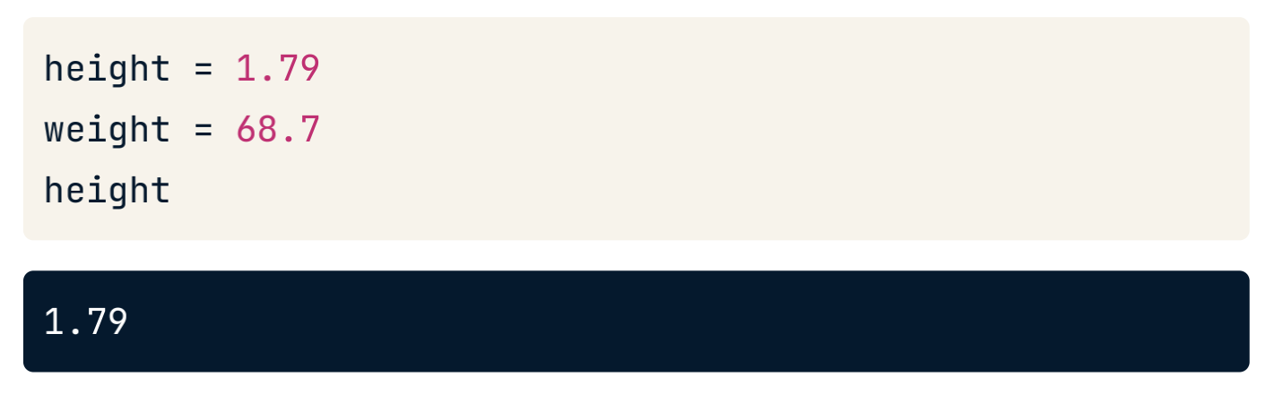
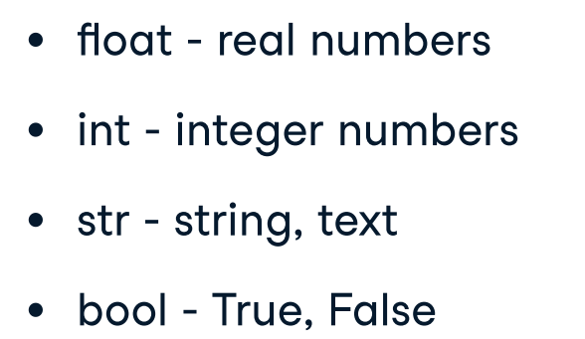
Python Variable & Types
Nama yang spesifik dan peka huruf besar/kecil.
© Copyright by Digital Skola 2020

Slide 5
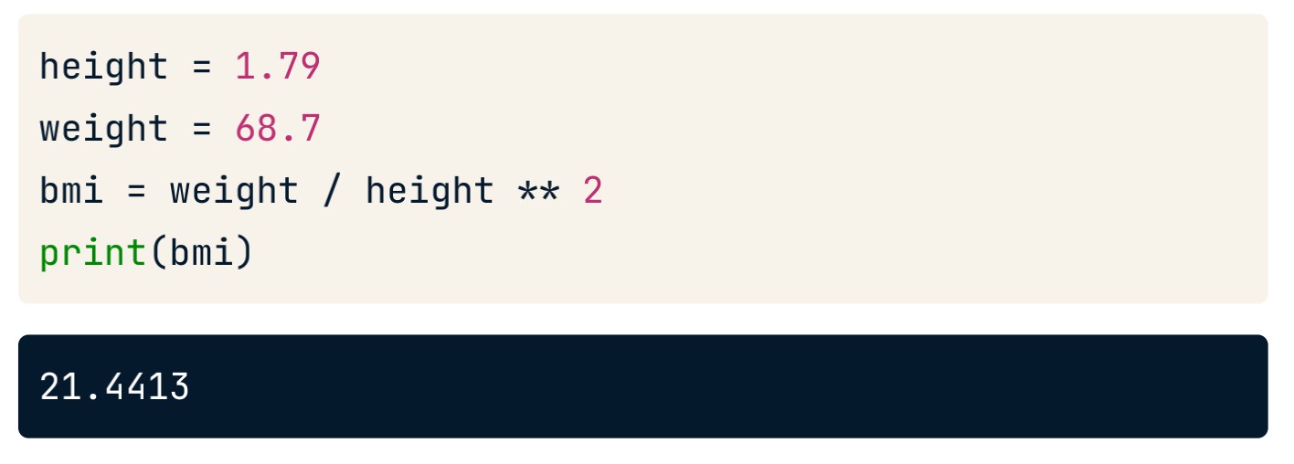
Python Variable & Types
Dapat digunakan untuk melakukan kalkulasi
© Copyright by Digital Skola 2020

Slide 6
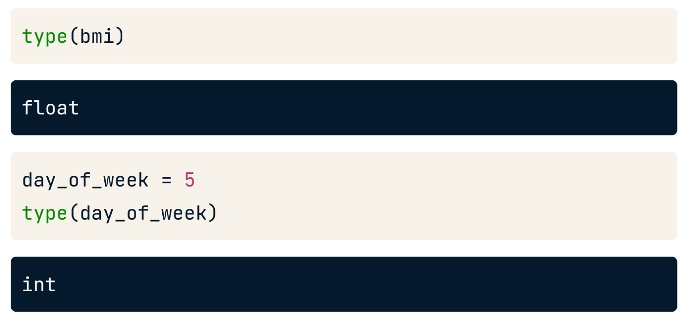
Python Types
© Copyright by Digital Skola 2020

Slide 7
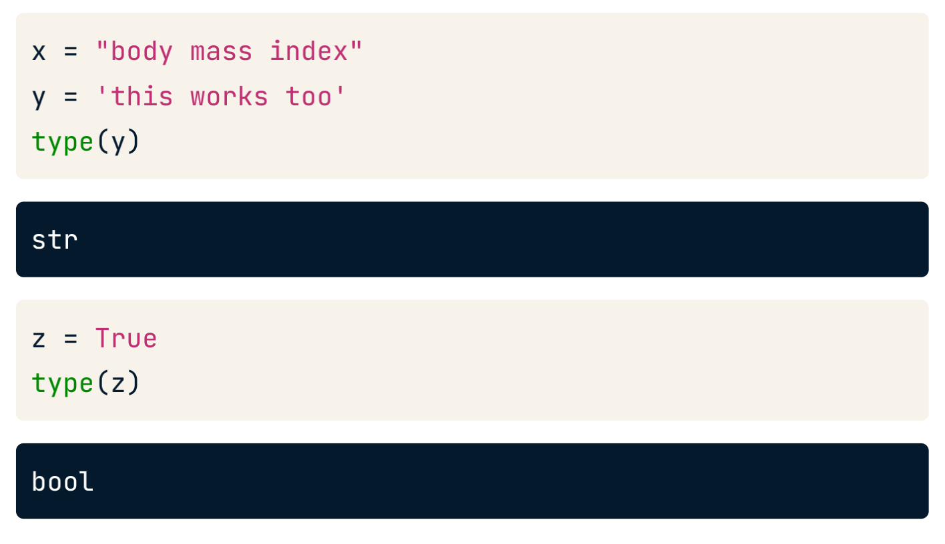
Python Types
© Copyright by Digital Skola 2020

Slide 8
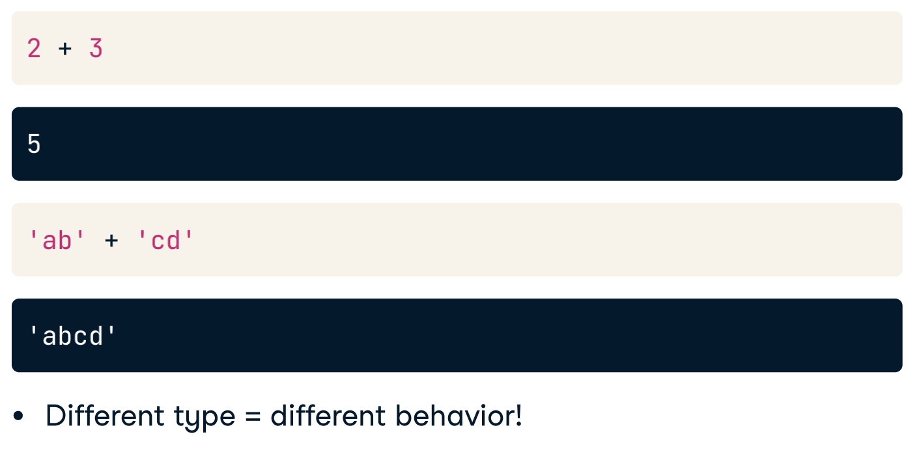
Python Types
© Copyright by Digital Skola 2020

Slide 9
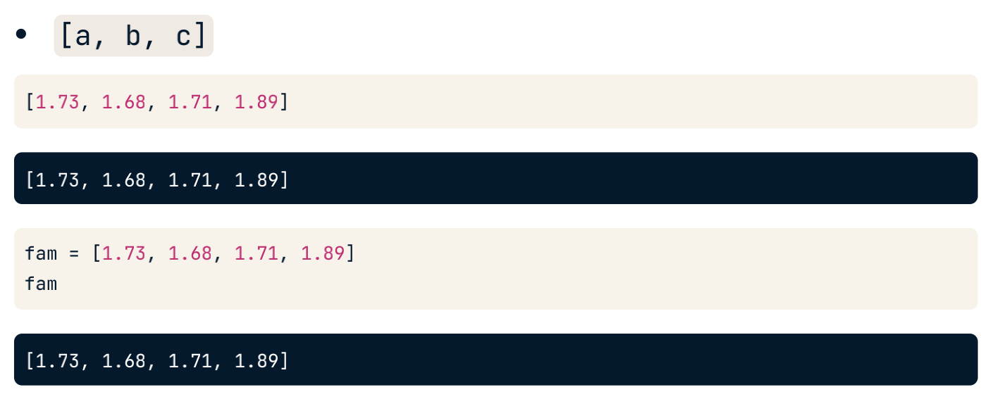
Python List
Berisi kumpulan nilai.
Berisi jenis data apa pun.
Berisi jenis data yang berbeda.
© Copyright by Digital Skola 2020

Slide 10
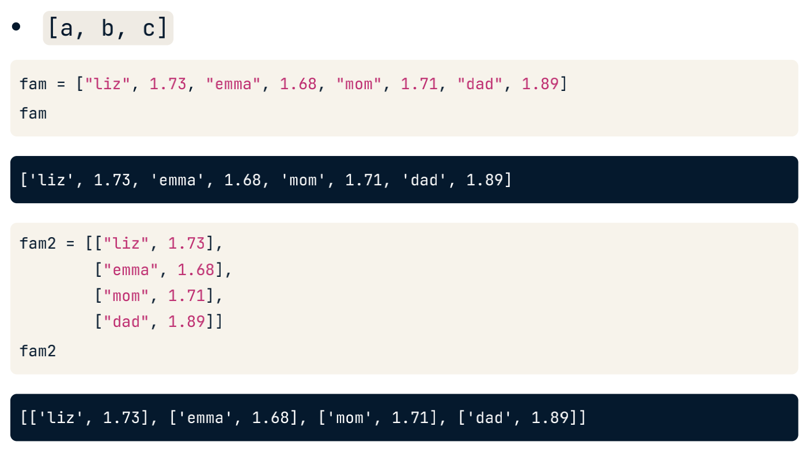
Python List
© Copyright by Digital Skola 2020

Slide 11
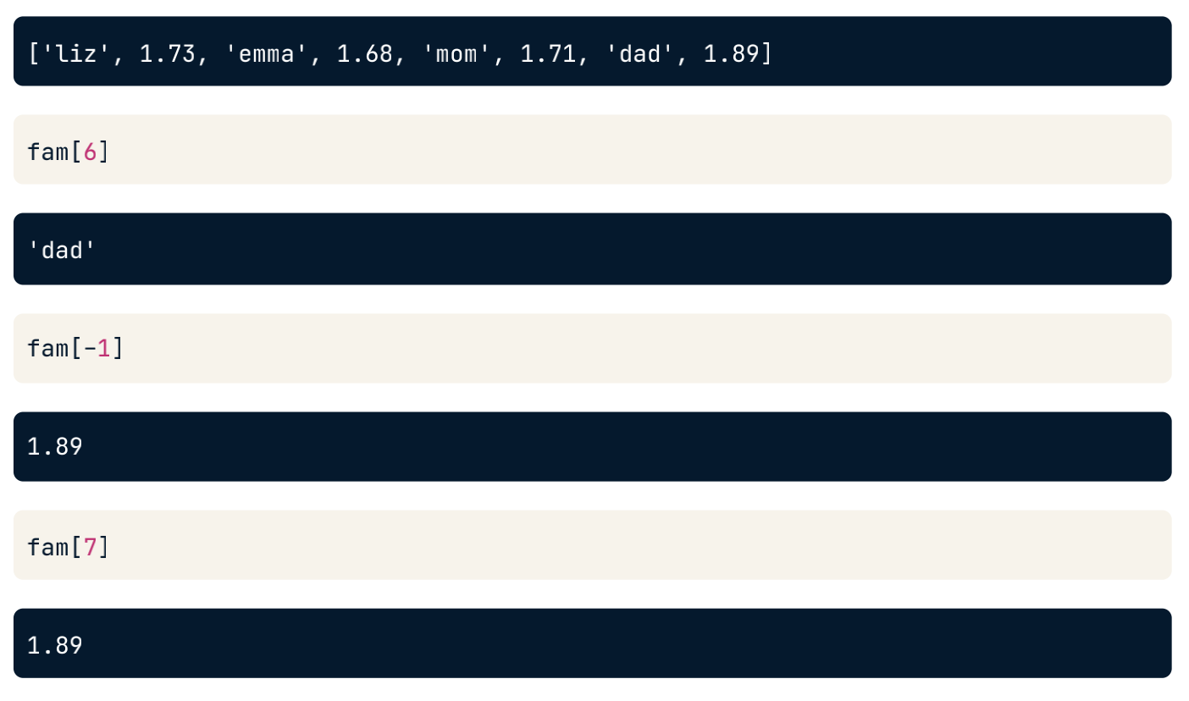
Subsetting List
© Copyright by Digital Skola 2020

Slide 12
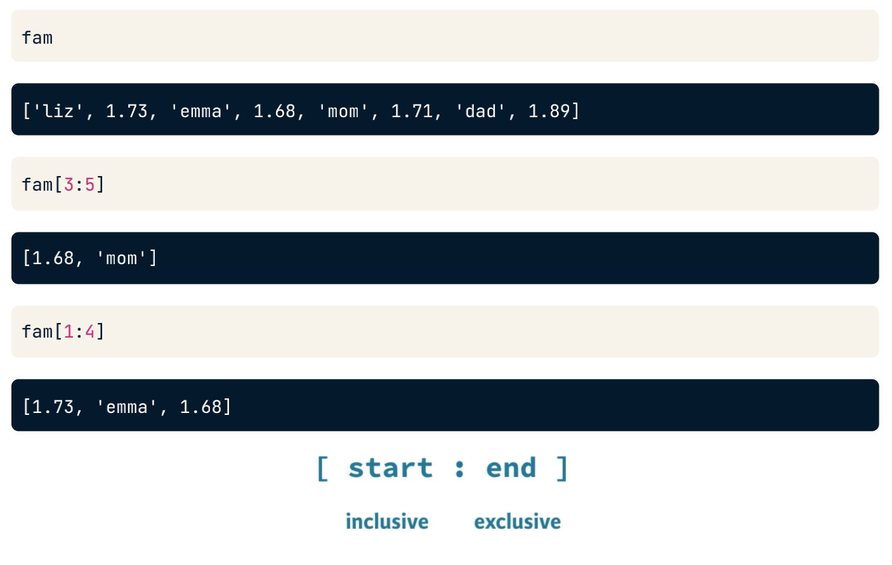
Slicing List
© Copyright by Digital Skola 2020

Slide 13
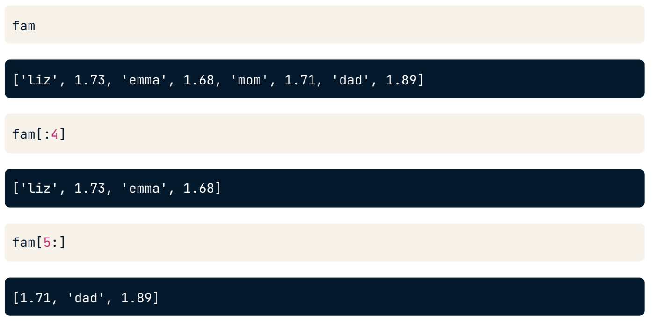
Slicing List
© Copyright by Digital Skola 2020

Slide 14
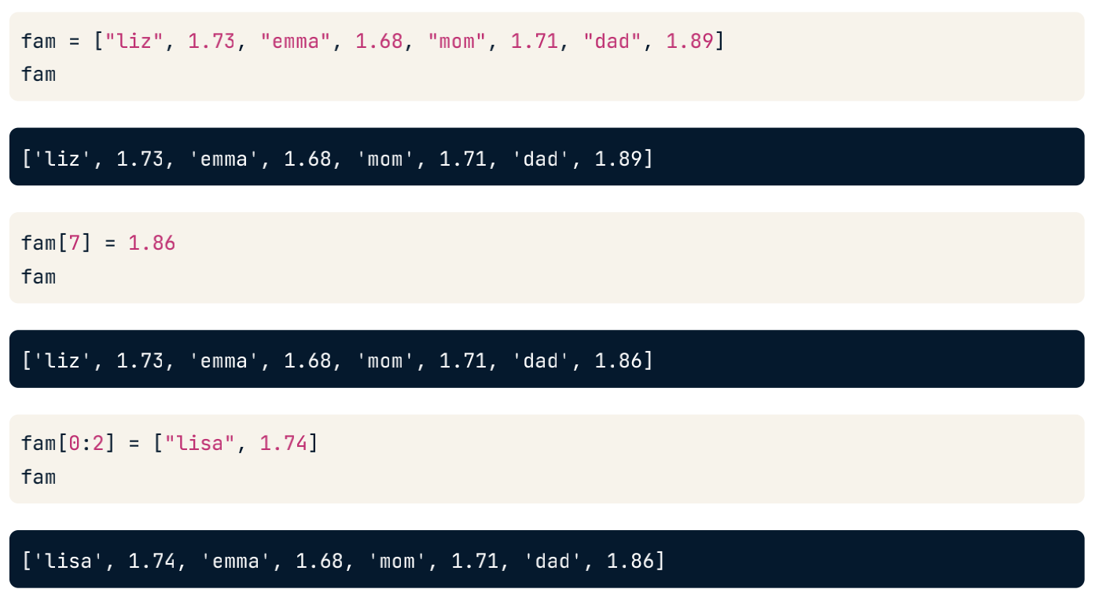
Manipulating List
Ubah elemen daftar.
Tambahkan elemen daftar.
Hapus elemen daftar
© Copyright by Digital Skola 2020

Slide 15
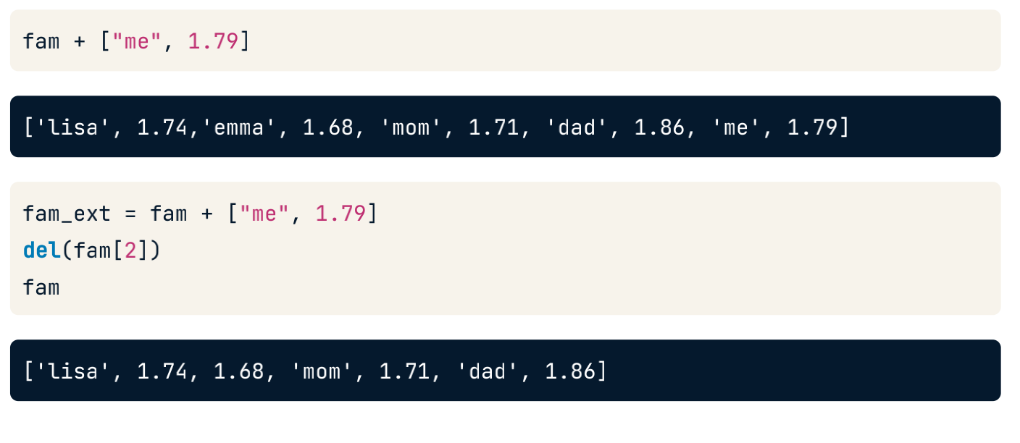
Adding & Removing List Elements
© Copyright by Digital Skola 2020

Slide 16
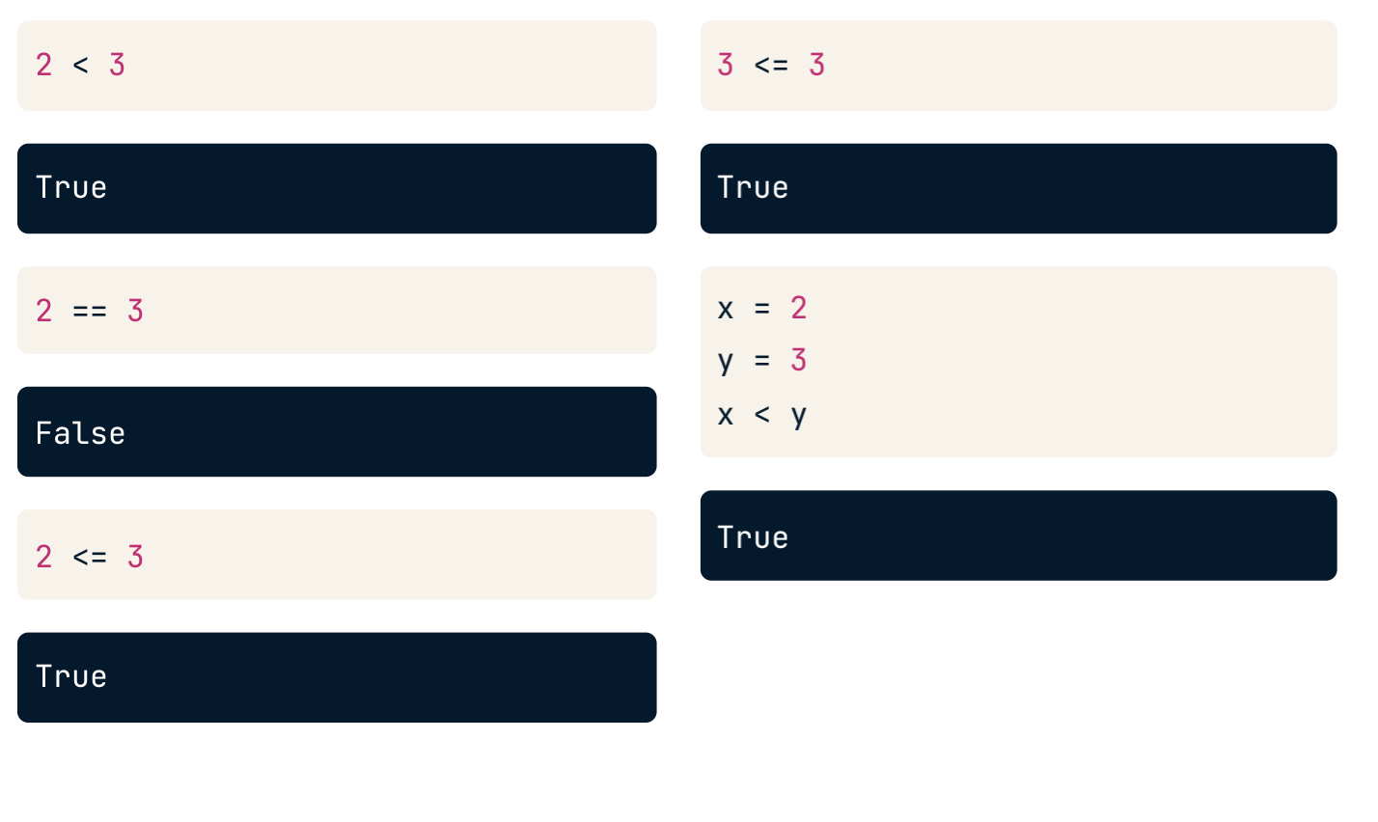
Numeric Comparison
© Copyright by Digital Skola 2020

Slide 17
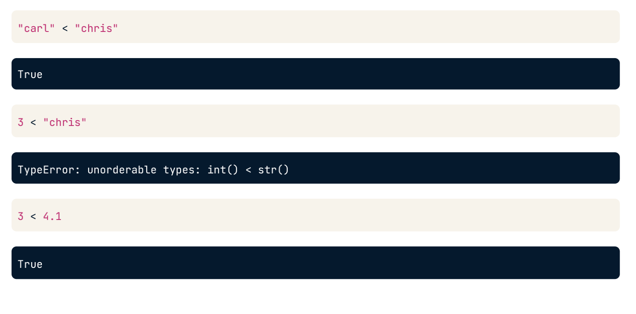
Other Comparison
© Copyright by Digital Skola 2020

Slide 18
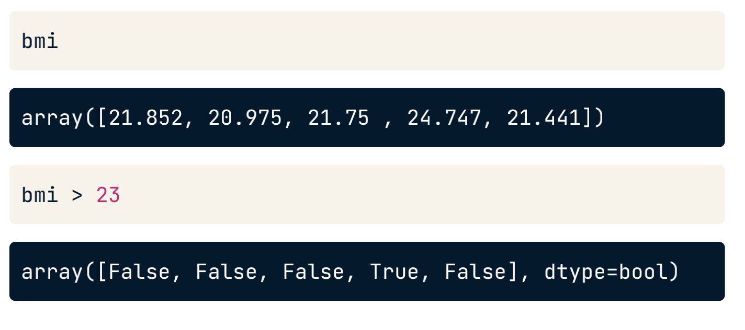
Other Comparison
© Copyright by Digital Skola 2020

Slide 19
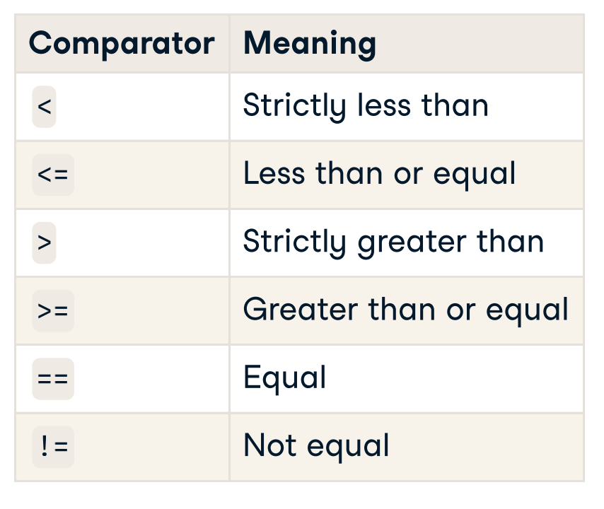
Comparators
© Copyright by Digital Skola 2020

Slide 20
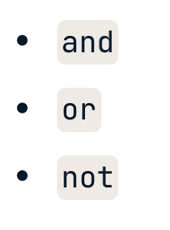
Boolean Operators
© Copyright by Digital Skola 2020

Slide 21
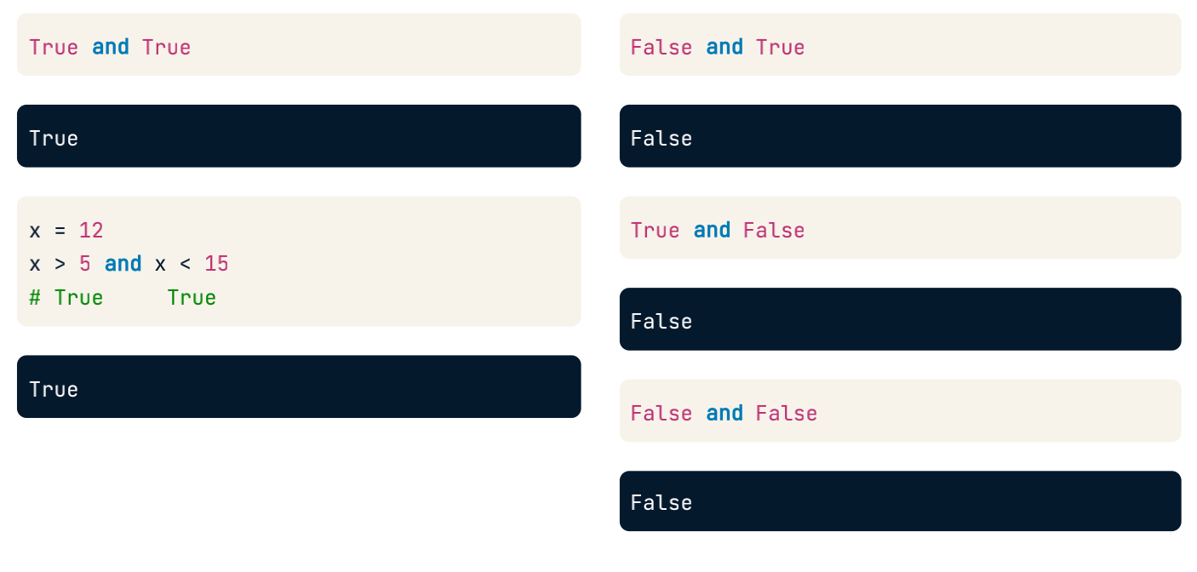
Boolean Operators - and
© Copyright by Digital Skola 2020

Slide 22
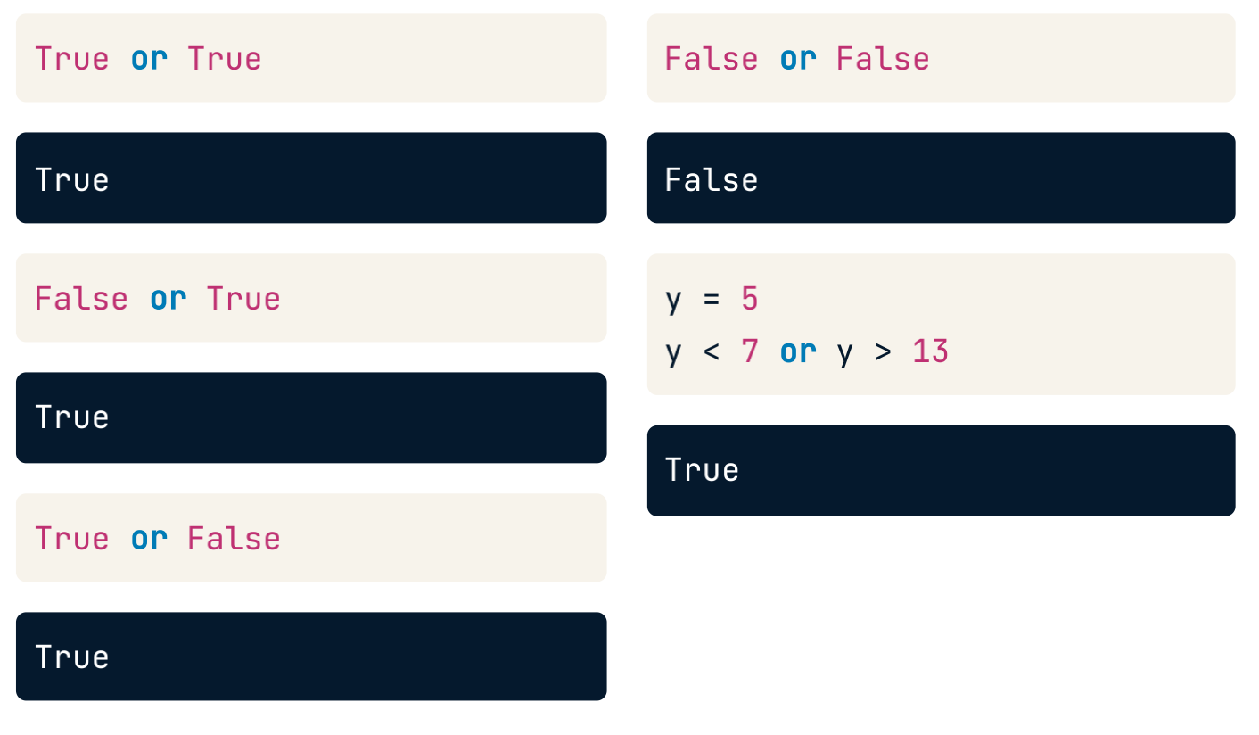
Boolean Operators - or
© Copyright by Digital Skola 2020

Slide 23
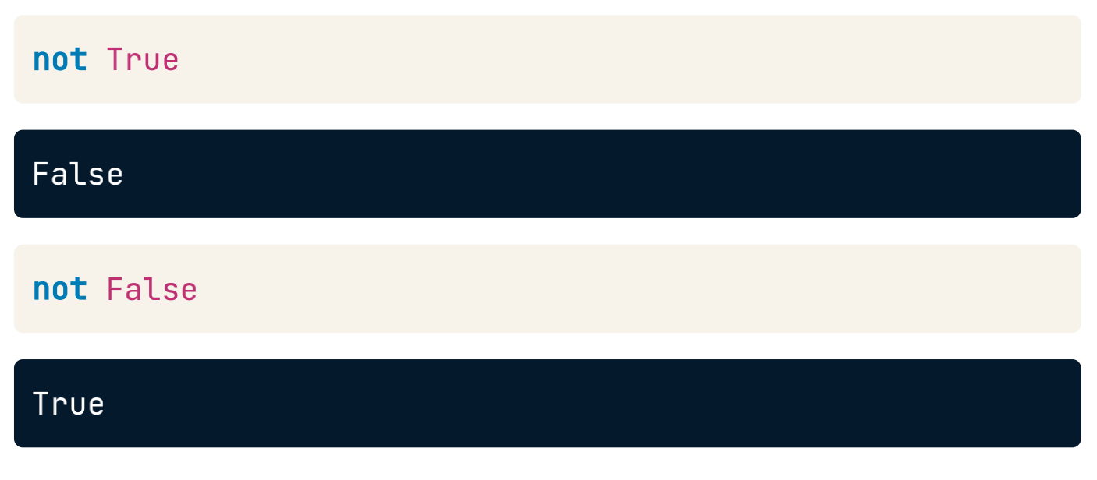
Boolean Operators - not
© Copyright by Digital Skola 2020

Slide 24
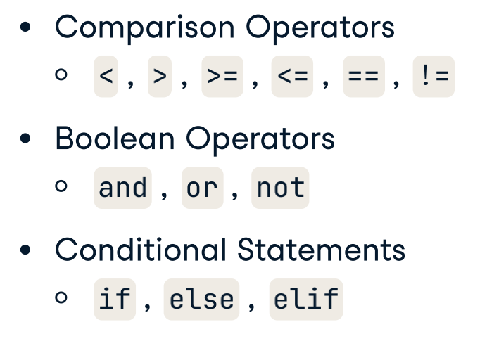
Python Operators
© Copyright by Digital Skola 2020

Slide 25
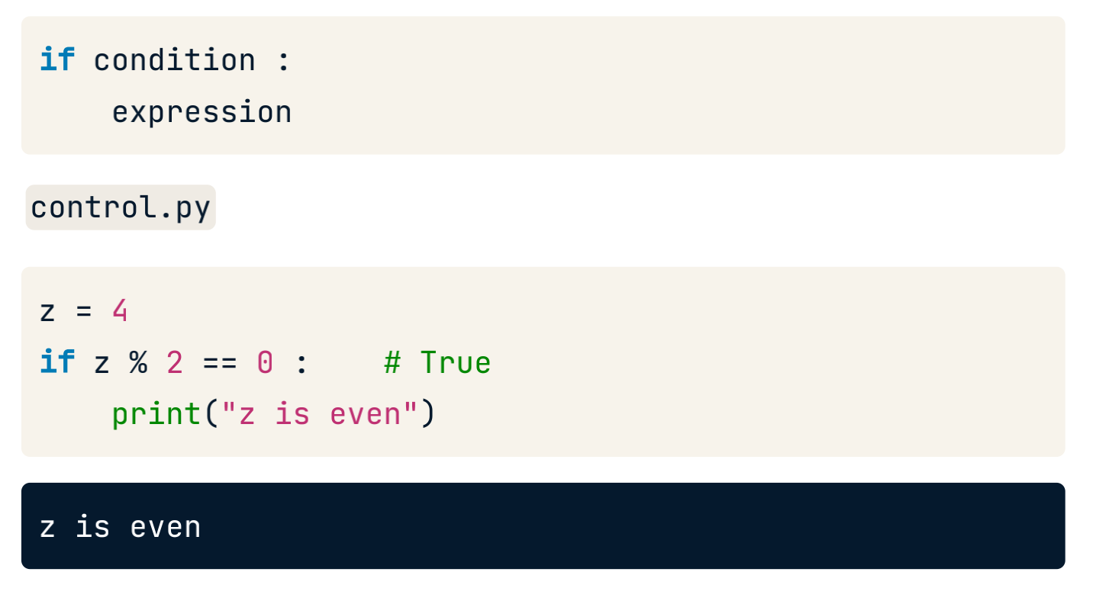
Python Condition - If
© Copyright by Digital Skola 2020

Slide 26
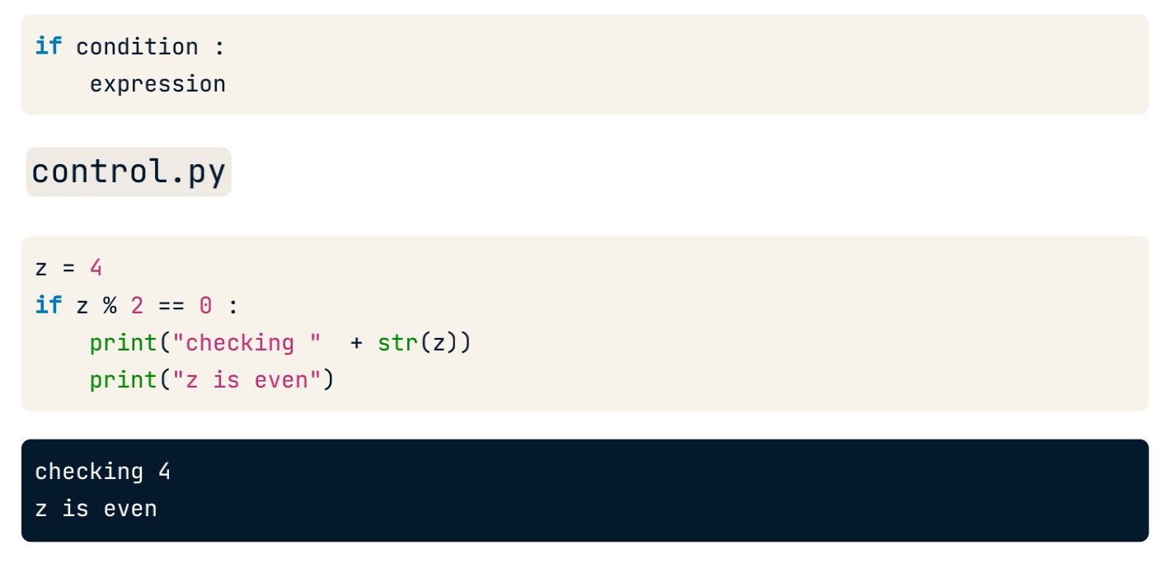
Python Condition - If
© Copyright by Digital Skola 2020

Slide 27
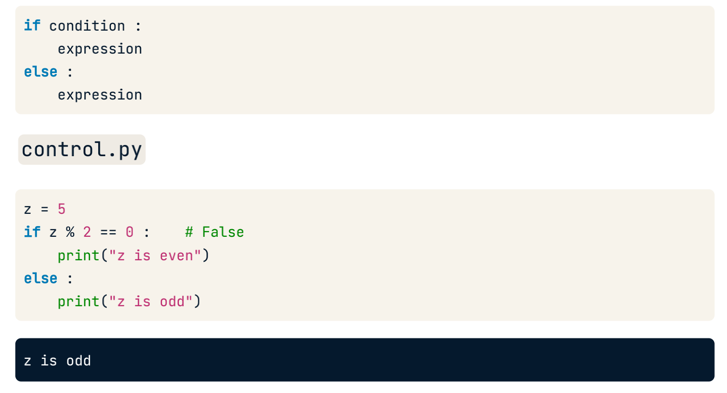
Python Condition - If Else
© Copyright by Digital Skola 2020

Slide 28
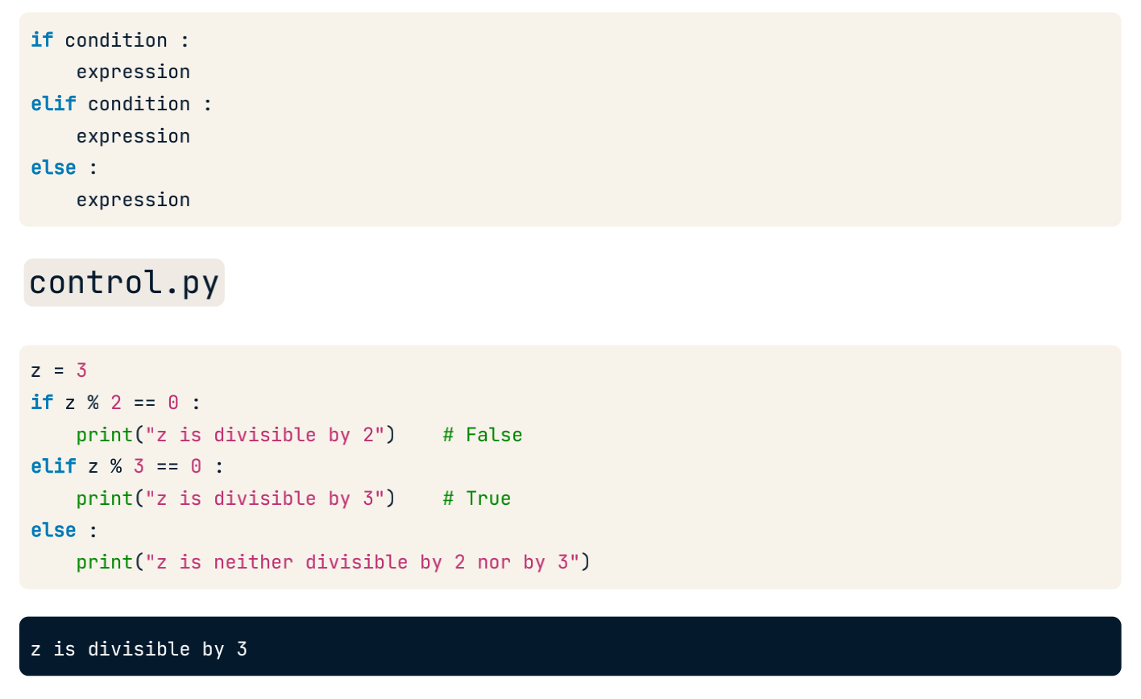
Python Condition - If Elif Else
© Copyright by Digital Skola 2020

Slide 29


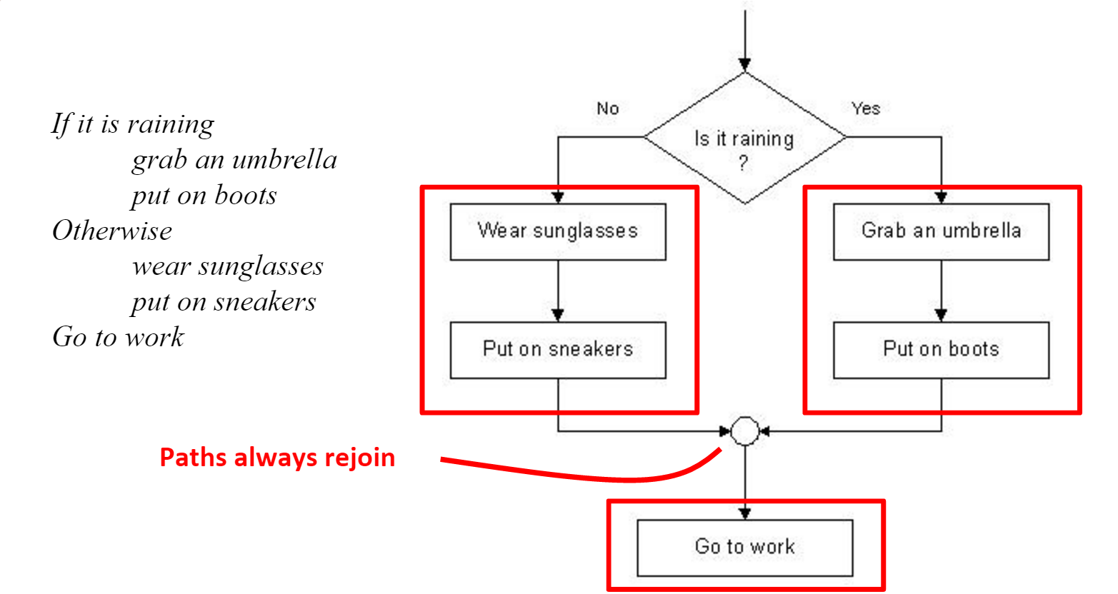

Flowchart of Conditions
© Copyright by Digital Skola 2020

Slide 30
Flowchart of Conditions
© Copyright by Digital Skola 2020

Slide 31
Conditions in Python
Pada Python, if statement menunjukkan bagaimana kode kita melakukan suatu proses decision-making.
Conditions akan mengeksekusi kode dimana kondisi yang diberikan outputnya true.
Jika outputnya false, maka akan ada else statement yang dieksekusi yang memuat kondisi tertentu yang tidak di-handle sebelumnya
if <expression>
<Statement>
else
<Statement>
© Copyright by Digital Skola 2020

Slide 32
Conditions in Python
Pengkondisian else dan else if (elif)
Kata kunci elif adalah cara pemrograman python untuk mengatakan "jika kondisi sebelumnya tidak benar, maka coba kondisi ini". Kata kunci else menangkap apa pun yang tidak ditangkap oleh kondisi sebelumnya.
a = 90
b = 50
if b > a:
print("b lebih besar dari a")
elif a == b:
print("a sama dengan b")
else:
print("a lebih besar dari b")
© Copyright by Digital Skola 2020

Slide 33
Flowchart of Conditions
if rain
grab umbrella
put on boots
else
wear sunglasses
put on sneakers
go to work
© Copyright by Digital Skola 2020

Slide 34
Flowchart of Conditions
Flow chart diagram adalah penggambaran proses dari control flow yang akan dibuat.
Flow chart diagram terdiri dari beberapa bentuk bangun datar yang memiliki bentuk dan fungsinya masing-masing
start / finish
proses yang dikerjakan
kondisi percabangan / pilihan
© Copyright by Digital Skola 2020

Slide 35
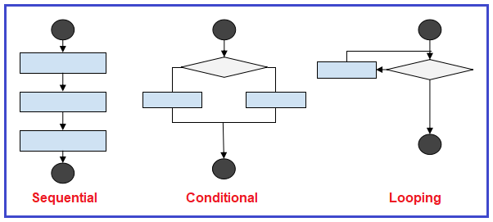
Control Flow
Control Flow adalah urutan dari eksekusi program
Control flow dari Python ditetapkan dengan conditional statements, loops, and function calls.
Python memiliki 3 tipe dari control structures
© Copyright by Digital Skola 2020

Slide 36
Control Flow
a=20
b=10
c=a-b
print("a-b =",c)
a = 3
b = 5
if a > b:
print("a is bigger than b")
else:
print("a is smaller than b")
print("Done")
© Copyright by Digital Skola 2020

Slide 37
Conditions in Python
Python mendukung logical conditions seperti di matematika:
Equals: a == b
Not Equals: a != b
Less than: a < b
Less than or equal to: a <= b
Greater than: a > b
Greater than or equal to: a >= b
© Copyright by Digital Skola 2020

Slide 38
“If” Statement
Single Condition (If)
a = 3
if a == 3:
print("a is three")
output: a is three
Two Condition (If -> Else)
a = 5
b = 5
if a != b:
print("a and b is not the same")
else:
print("a and b is the same")
output: a and b is the same
Multiple Condition (If -> Elif -> Else)
a = 3
b = 5
if a > b:
print("a is bigger than b")
elif a < b:
print("a is smaller than b")
else:
print("a and b is the same")
output: a is smaller than b
© Copyright by Digital Skola 2020

Slide 39
“If” Statement
Single Expression
a = 5
b = 7
if a <= b:
print("a is smaller than b")
output: a is smaller than b
Multiple Expression
a = 3
b = 7
c = 20
if a < b and b < c:
print("a is smaller than b")
output: a is smaller than b
a = 3
b = 7
c = 20
if c > b or c < a:
print("At least one of the expression is True")
output: At least one of the expression is True
© Copyright by Digital Skola 2020

Slide 40
“If” Statement Shorthand
If
a = 3
if a == 3:
print("a is three")
output: a is three
If else
a = 5
b = 5
if a == b:
print("same")
else:
print("different")
output: a and b is the same
a = 3
if a == 3: print("a is three")
a = 5
b = 5
print("same") if a==b else print("different")
© Copyright by Digital Skola 2020

Slide 41
Nested if
x = 50
if x > 20:
print("Above twenty, ")
if x > 40:
print("and also above 40")
else:
print("but not above 40")
else:
print(“Below twenty”)
Output: Above twenty, and also above 40
© Copyright by Digital Skola 2020

Slide 42

Let’s code!
Copy the Colab to your Drive so you can edit it yourself!
Open the Google Colab link above
Open File > Save a copy in Drive
Open your Google Drive
Open the copied Colab located in your Drive
Datatypes - https://colab.research.google.com/drive/1uhBrWyi2rDg6fR7dY1pR7_7QvFv-WKGS?usp=sharing
Conditions - https://colab.research.google.com/drive/1hkcs7C8rpyXTTvg4KfX1G8BbGba8d_gc?usp=sharing
© Copyright by Digital Skola 2020

Slide 43
Thank
YOU
© Copyright by Digital Skola 2020

